Slide 1
Drivers and background for continuing collaborative project on monitoring activities
JOHAN BERTRAND, Andra
R&D division,
Monitoring and data treatment department
26 May 2015,PLANDIS Meeting

Slide 2
Drivers and background for continuing collaborative project on the ‘monitoring activities and associated stakeholder engagement during relevant phases of the radioactive waste disposal process’, international state-of-the-art overview, and outstanding work activities to be addressed by the MODERN Project

Slide 3
Outline
Outline
General consideration about monitoring
Motivation for a collaborative project about monitoring aspects
Modern (7th Framework Programme) results
Modern2020 (New Euratom FP 2014-2018 in Horizon 2020) objectives

Slide 4
General consideration about monitoring

Slide 5
Definition
Monitoring is defined as continuous or periodic observations and measurements of parameters and indicators & characteristics (i) to evaluate the behaviour of a system or a subsystem and/or (ii) to evaluate the impact of the system or subsystem on its environment

Slide 6
Monitoring for different types of disposal
Monitoring
To support the basis for repository performance evaluations
To support operational safety.
To support environmental protection
To support nuclear safeguards

Slide 7
Monitoring activities throughout the lifetime of a disposal facility.
Source AEN, 2011

Slide 8
Motivation for a collaborative project about monitoring aspects

Slide 9
Examples of repository design
Repository layout in Finland
(Posiva - crystalline host rock)
French concept for horizontal, vitrified waste disposal cells
(Andra – sedimentary host rock)
German concept for repository disposal boreholes DBE TEC - evaporite host rock)
Is there a “one size fits all” approach to monitoring?

Slide 10
Pre-MoDeRn references
IAEA TECDOC 1208 (2001)
Monitoring of Geological Repositories for High Level Radioactive Waste
European Commission Project Report EUR 21025 (2004)
Thematic Network on the Role of Monitoring in a Phased Approach to Geological Disposal of Radioactive Waste
IAEA Safety Requirements WS-R-4 (2006)
Geological Disposal of Radioactive Waste – Requirements on monitoring programs
IAEA Safety Standards GSR Part 4 (2009)
Safety Assessments for Facilities and Activities – e.g. Maintenance of the safety assessment
IAEA Safety Standards – Draft Safety Guide DS357 (2011)
Monitoring and Surveillance of Radioactive Waste Disposal Facilities
All program specific developments (WMOs) and regulatory/safety guidelines
MoDeRn National Context Summary Report and Country Annexes Report
Notes:
The MoDeRn projects comes after several projects, led by IAEA or the EC.
The role and objectives of monitoring, in particular, were defined.
For instance, in 2001, the IAEA gave 5 purposes to monitoring:
Provide information for making decisions
Strengthen understanding
Provide information to give the society at large confidence to take decisions
Accumulate environmental database on repository sites for further decisions
Safeguards
The ETN brought in the phased approach.
The objective of confirming the conditions defined in the safety case were subjects of the IAEA 2006 project, while in 2012 it brought closer attention to the links between the safety case and the monitoring program

Slide 11
Modern-FP7 Monitoring Developments for safe Repository operation and staged closure

Slide 12
The MoDeRn Project in a nutshell
MoDeRn is a collaborative project co-funded by the European Commission under the 7th Framework Programme
EURATOM Programme
Call for propositions FP7-Fission-2008 « Nuclear Fission and radiation protection »
Topic « Strategies and technologies for repository monitoring »
Duration: 1st of May 2009 – 31 October 2013 (4 1/2 years)
It aims at providing a framework for the development and possible implementation of monitoring activities and associated stakeholder engagement during relevant phases of the radioactive waste disposal process.
18 partners from 12 countries
Coordinator : Andra
Budget : 5 million €
EU contribution : 2.8 million €
Published project documents are available on:
www.modern-fp7.eu
Notes:
The successful implementation of a repository program relies on both the aspects of a sound safety strategy and on social aspects such as SH acceptance and confidence.
Monitoring has the potential to contribute to both these aspects and thus to play an important role in the international waste management Organizations ability to move forward towards a successful, i.e. safe and accepted implementation of the disposal process for which they are responsible

Slide 13
Project Partners
18 partners - 12 countries - 8 national agencies
Japan (RWMC)
USA (Sandia)
Switzerland (Nagra, ETH Zurich)
Non-EU countries:
France
(Andra)
Spain
(Enresa and Aitemin)
Germany
(DBE TECHNOLOGY)
Belgium (Euridice, UA)
United-Kingdom
(NDA, UEA, GSL)
Netherlands (NRG)
Finland
(Posiva)
Czech Republic (RAWRA)
Sweden
(SKB, UGOT)
EU Countries
Grimsel (Switzerland)
Mol (Belgium)
Bure (France)
RTD and demonstration in URLs
Notes:
The MoDeRn work program needs a complementary view on monitoring approaches in different national contexts: adequate technical expertise to allow for progress in bringing monitoring closer to implementation stage, and an understanding of what SH, and especially the public concerned by repository projects might expect.
To achieve hat, the consortium brings together 10 organizations in Europe, US and Japan, responsible in their country for RAW management, 2 partners with extensive experience in monitoring activities in URL and 3 partners having substantial experience with public engagement issues.

Slide 14
MoDeRn Objectives
Develop a reference framework to guide development, implementation, use, and evolution of a monitoring program - within its national context
Develop:
Provide recommendations on how to develop monitoring objectives
Provide a knowledge base on national monitoring contexts
Implement
Provide a state-of-the art of relevant monitoring technologies and discuss remaining technological obstacles and technologies to develop
Provide demonstrations of the use of non-intrusive monitoring techniques and of implementing monitoring under construction conditions
Discuss technical feasibility, limitations, and possible implementation strategies
Use
Provide and discuss options for the potential use of monitoring results to assist decision making
Provide recommendations on engagement with lay stakeholders on complex socio-technical issues such as repository monitoring
Notes:
The overall objective of MoDeRn is
to take the State of the Art of broadly accepted, main monitoring objectives to a level of description which is closer to actual implementation during the staged approach of the disposal process,
to verify whether such an implementation is able to address expert and lay SH expectations,
to provide an understanding of activities and available technologies that can be implemented in a repository context, and
to provide recommendations for future SH engagement activities

Slide 15
Influence of National Contexts
Societal “boundary conditions”
Legal/regulatory requirements:
A specific parameter (site piezometry…)
Pre-closure management (retrievability…)
A specific strategy (monitor pilot facility…)
Expert stakeholder requirements
Lay stakeholder requirements
Physical “boundary conditions”
Waste inventory
Host rock, local/regional hydrogeology, transport properties
Repository layout and engineered barriers design
Waste Disposal Package (concrete, steel, copper, special alloys…)
Cavern, drift, borehole disposal
Buffer (swelling clay…), backfill
Rock support/liner (rock bolts, shotcrete, concrete, steel…)
Seals (at disposal cell/drift, in access galleries, in surface to depth infrastructure)
MoDeRn to develop a “reference framework”, not a “reference program”
Notes:
Factors defining the national contexts, which are significantly different, may be classified, on first approach, as related to social conditions on one hand and physical conditions on the other. These criteria, refined to a greater level of details, make up boundary conditions, shaping the repository programs and parts of the monitoring program .The importance of the national contexts in developing a monitoring program is recognized and it is not proposed to transpose a program in a different context, governed by different requirements and having different combinations of host rocks, disposal concepts, engineered barriers and waste types.

Slide 16
Key steps to develop/implement/use/evolve a monitoring program
Reference Framework
Objectives
Objectives
Develop
+
Implement
Expectations from monitoring / What to monitor
Expectations from monitoring / What to monitor
Implementation Technology and Strategies
Implementation Technology and Strategies
How to implement and conduct monitoring
How to implement and conduct monitoring
Analysis
Analysis
Use
+
Evolve
Interpret monitoring results / Answer objectives
Interpret monitoring results / Answer objectives
Phasing
Phasing
Information
Information
How to evolve monitoring
How to evolve monitoring
Assist disposal process management
Assist disposal process management
End monitoring
End monitoring
Notes:
The reference framework provides a process to follow as a guidance for national programs on how to develop, implement and use a monitoring program.
The reference framework is a structured approach looking at themes such as:
Develop objectives
Design monitoring systems
Strategies
Feasibility
R&D
Limitations
Include monitoring in the overall governance of disposal process - decisions - deviation from expected results
SH confidence contribution

Slide 17
Example of defining a monitoring objective
Canister safety function: containment of the radionuclides = watertightness during a period of time
Monitoring objective: duration of the watertightness = as long as canister not pierced by corrosion or mechanical stress
Monitoring objective: evaluate corrosion and applied mechanical stress
relate parameters to Features, Events and Processes identified by prior research and available understanding
Notes:
It derived from this safety case – monitoring plan relationship that a monitoring plan can only be designed when a throrough understanding of the features and processes of a repository system has been achieved, through a research program

Slide 18
Conclusions
The MoDeRn project developed a set of documents to support the design and implementation of monitoring programs:
A framework, presenting the workflow, with a systematic top-down approach to developing monitoring programs
Case studies provide examples of monitoring programs in 3 host rocks
The State of the Art in technologies for monitoring, complemented by 5 programs of research and demonstration in URL
The basis for SH communication and National Engagement Reports
Information available on MoDeRn website
www.modern-fp7.eu
National Contexts

Slide 19
introduction
IGD-TP Joint Activity 6 on Monitoring
IGD-TP Exchange Forum 2013 in Prague: a specific working group on Monitoring
One of the objective was to identify specific areas related to repository monitoring in which further research is required, as starting point for the definition of the objectives and scope of a collaborative project on repository monitoring to be submitted in the first call of Horizon2020 to be opened one year later
Based on the outcomes of the FP7 MoDeRn project and on the discussions held in Prague, it was suggested and approved by the IGD-TP Executive Board to build a proposal for H2020 that would be coordinated by Andra
Modern2020 proposal was submitted to EC in September 2014 and was positively evaluated in February 2015
The project will officially start on June 1st, 2015

Slide 20
Modern2020 Development and Demonstration of monitoring strategies and technologies for geological disposal

Slide 21
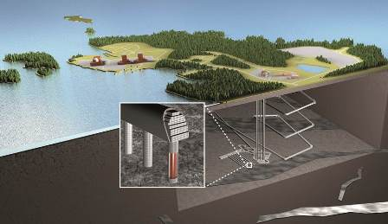
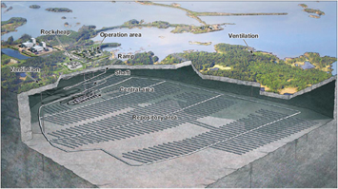
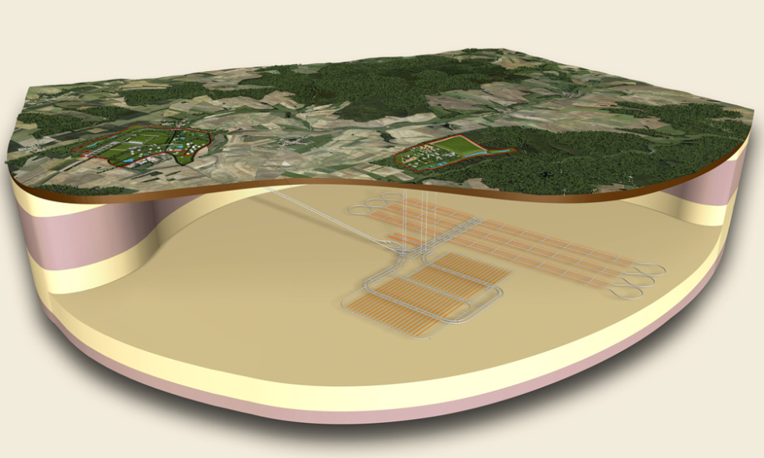
Three countries with the same challenge-License application
SKB – Swedish Concept-03/2011
Posiva – Finish concept-02/2015
Andra – French Concept-2017

Slide 22
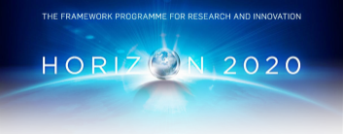
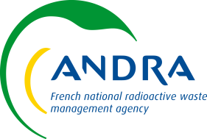
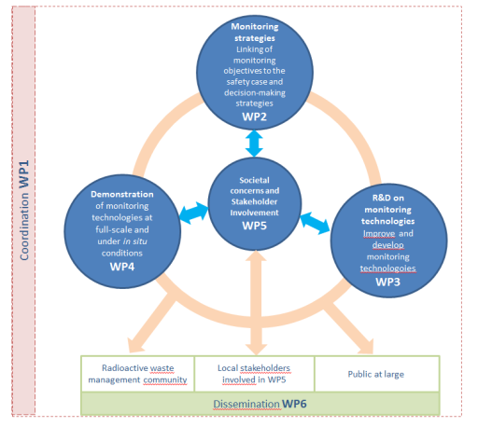
Modern2020
Modern2020 project is a collaborative project proposal under Euratom Framework Program 2014-2018 in Horizon 2020
Call for propositions H2020-Fission-2014 « Contribute to the development of solutions for the management of ultimate radioactive waste “
NFRP-06-2014: Supporting the implementation of the first-of-the-kind geological repositories (14,6 M€)
Project duration : 4 years
official start: June 2015
It aims at providing a framework for the development and possible implementation of monitoring and associated stakeholder engagement during operational phases of the radioactive waste disposal process.
Consortium: 28 partners EU + non-EU countries (Coordinator : Andra)
Total Budget : around 8,9 M€
EC Contribution: 6M€

Slide 23
Work Programme
Strategy: Linking of monitoring objectives to the safety case and decision-making strategies.
Technology: Research and development on monitoring technologies.
Demonstration and Practical Implementation: Demonstration of monitoring technologies at full-scale and under in situ conditions.
Societal concerns and Stakeholder Involvement: Development and evaluation of ways for integrating public stakeholders concerns and societal expectations into national repository monitoring programmes

Slide 24
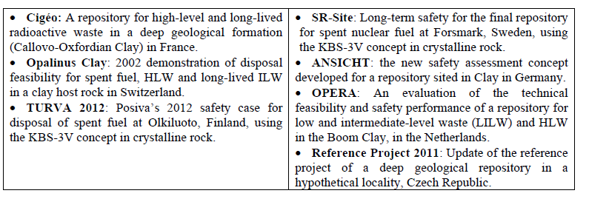
Work Programme
Strategy: Linking of monitoring objectives to the safety case and decision-making strategies.
WP2 will address the development of monitoring programme design basis,
monitoring strategies and the role of monitoring in decision making
by focusing on specific national programmes

Slide 25
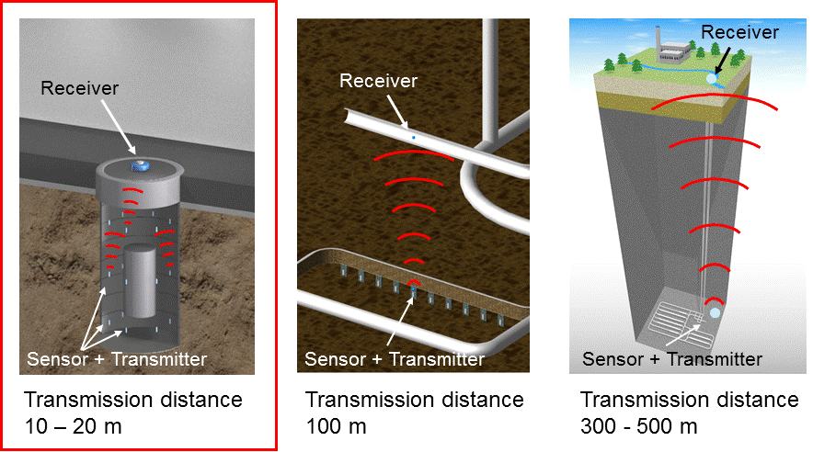
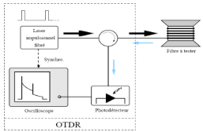
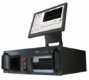
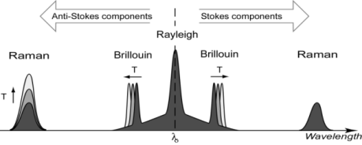
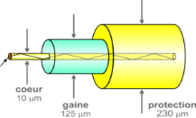
Work Programme
Technology: Research and development on monitoring technologies.
ε
ε
T_{9,995}
T_{9,996}
T_{9,997}
T_{9,998}
T_{9,999}
WP3 is to conduct research and technical developments on monitoring technologies

Slide 26
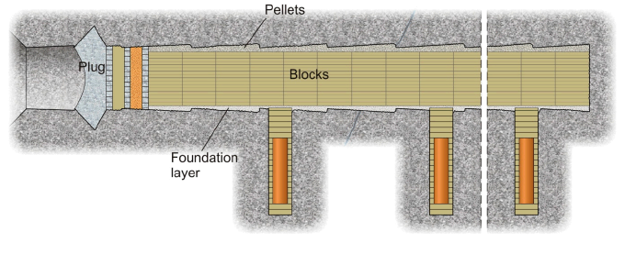
Work Programme
Demonstration and Practical Implementation: Demonstration of monitoring technologies at full-scale and under in situ conditions.
KBS-3V concept
HA-cell concept
to demonstrate the practical implementation of specific monitoring plans (developed in WP2) through several in-situ demonstrations including the application of innovative monitoring techniques (WP3) to further enhance the knowledge on the operational implementation of specific disposal monitoring

Slide 27
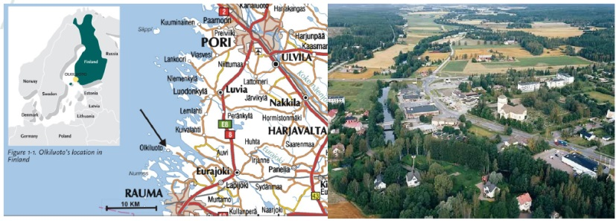
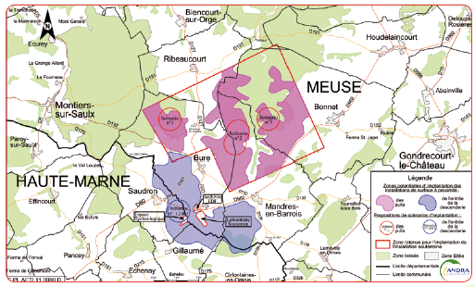
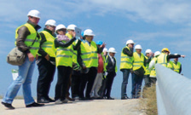
Societal concerns and Stakeholder Involvement: Development and evaluation of ways for integrating public stakeholders concerns and societal expectations into national repository monitoring programmes
stakeholder engagement activity will be set up throughout the project’s lifetime,
and in direct relation to the R&D work developed in work packages 2, 3 and 4

